Slide 1

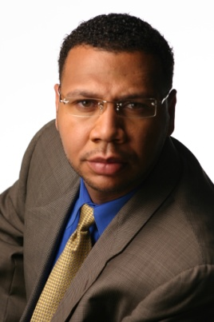

Master Key System
Part Ten
Presented
By
Dr. Peter C. Rogers, D.D., PhD.

Slide 2
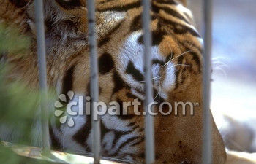

Master Key System
Part Ten
What holds a tiger within a cage?

Slide 3
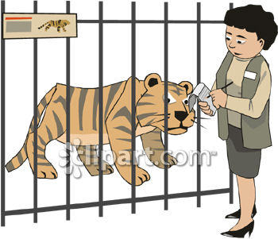

Master Key System
Part Ten
“It is not the bars that hold the Tiger within a cage, but the space between the bars that holds the tiger within a cage”

Slide 4
Master Key System
Part Ten
You have been taught that you are in a cage.
You have been lead to believe that you cannot do things that you most certainly can.
Your thoughts are the bars of the cage, but it is your attitude that actually confines you.

