Slide 1



Master Key System
Part Twenty
“The Spirit of Things”
Presented
by
Dr. Peter C. Rogers, D.D., PhD.

Slide 2






Master Key System
Part Twenty
The Spirit of Things
There is no place that God is not.
The results of beneficial thoughts is called “Good.”
The results of destructive thoughts is called “Evil.”
Both are simply words to indicate the nature of thought.
Thought precedes action; action precedes conditions.

Slide 3
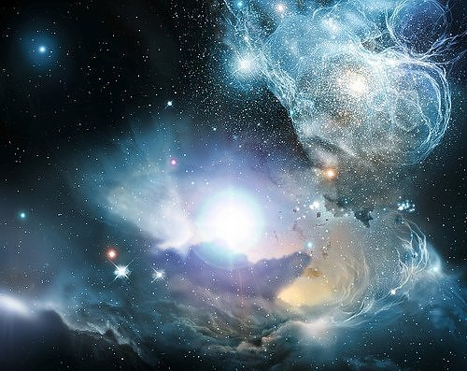

Master Key System
Part Twenty
The Spirit of Things
The essence of the Universe is within you; it is you.

Slide 4
Master Key System
Part Twenty
The Spirit of Things
If you think lack, limitation or discord you will see the results everywhere you look.
If you think poverty, unhappiness and disease, the results of your thoughts are certain.
That which you fear the most will come upon you.
You attract the results of your ignorance.

Slide 5
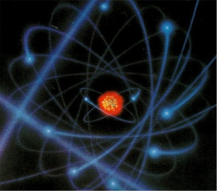
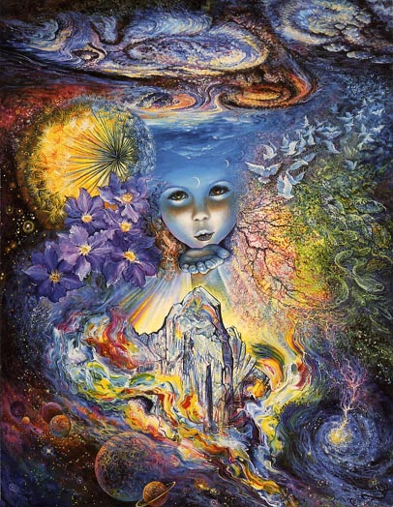

Master Key System
Part Twenty
The Spirit of Things
Once you recognize the Unity of all things and that the source of all power comes from within, you’re able to tap the source of inspiration.

Slide 6


Master Key System
Part Twenty
The Spirit of Things
In order to secure the larger supply, your demand must be increased. Once you increase your demand, the supply will follow. You will find yourself coming into a larger and larger supply of life, energy and vitality.

Slide 7
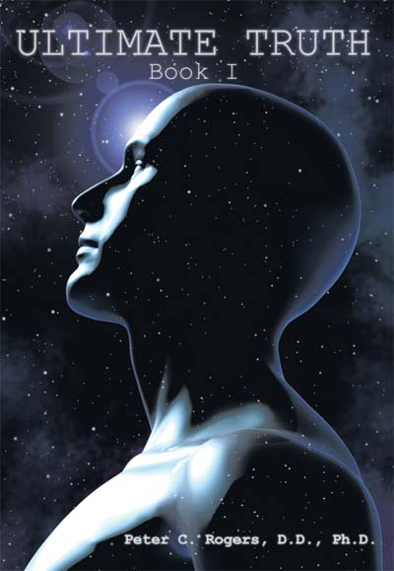
Master Key System
Part Twenty
The Spirit of Things
This Pranic Energy, or Pranic Ether, you could not exist a moment without it. It is the Cosmic Energy; it is the life of the Solar Plexus.
“If you take air away
you have a couple of
minutes before you die;
if you take water away
you have even more time;
and if you take food
away, you have more
time still, but if you break
Prana from Spirit, death
is instantaneous.” pg. 15
www.ultimatetruthbooks.com
www.drpeterrogers.com

Slide 8
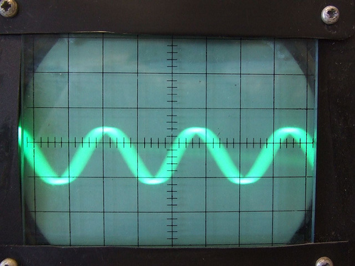
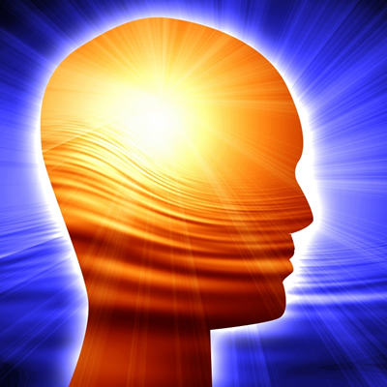
Master Key System
Part Twenty
The Spirit of Things
Thought is creative vibration.
The quality of your conditions depends upon the quality of your thoughts.
You cannot express what you do not have.
You must “be” before you can “do.”
You can “do” only to the extent that you “are.”
What you “do” coincides with what you “are.”
What you “are” depends upon what you “think.”
You cannot plant one kind of thought and reap the fruit of another.

Slide 9

Master Key System
Part Twenty
The Spirit of Things
A student asked a teacher, “How can I command whatever happens to me?”
“By being one with whatever happens.”
“What does that mean?”
“You really do not possess a separate Self which is apart from anything; you are one with all of life. However, in your misunderstanding you think there is a you and an event, which causes division and conflict. Give up your belief in a separate Self and oneness will be realized, which ends conflict. This is the secret of the ages. Come back to it everyday. You will change.”

Slide 10
Part Twenty
Main Points
Power depends upon recognition and use.
Recognition is consciousness.
You become conscious of power by thinking.
Correct scientific thinking is the true business of life.
Correct scientific thinking is the ability to adjust your thought processes to the will of the Universal. In other words, to cooperate with Natural Laws.

Slide 11
Part Twenty
Main Points
Correct scientific thinking is accomplished by securing a perfect understanding of the principles, forces, methods and combinations of you mind.
The Universal Mind is the basic fact of all existence.
All lack, limitation, disease and discord are due to the same law. The law operates non-stop bringing about conditions that correspond with the originating thought.
Inspiration is the art of realizing the omnipotence of omniscience.
The conditions with which you meet depends upon the quality of your thought. What you “do” depends upon what you “are” and what you are depends upon what you “think.”

Slide 12
Part Twenty
Study Questions
Upon what condition does power depend? Upon recognition and use.
What is recognition? Consciousness.
How do you become conscious of power? By thinking.
What then is the true business of life? Correct scientific thinking.
What is correct scientific thinking? The ability to adjust your thought processes to the will of the Universal. In other words, to cooperate with Natural laws.

Slide 13

Part Twenty
Study Questions
How is this accomplished? By securing a perfect understanding of the principles, forces, methods and combinations of mind.
What is this Universal Mind? The basic fact of all existence.
What is the cause of all lack, limitation, disease and discord? It is due to the operation of exactly the same law, the law operates relentlessly and is continually bringing about conditions in correspondence with the thought which originated or created them.
What is inspiration? The art of realizing the omnipresence of omnipotence.
Upon what does the conditions with which you meet depend? Upon the quality of your thought. Because what you “do” depends upon what you “are” and what you are depends upon what you “think.”

