Slide 1

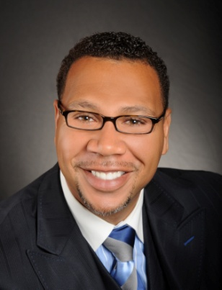

Master Key System
Part Twenty Two
“Spiritual Seeds”
Presented
by
Dr. Peter C. Rogers, D.D., PhD.

Slide 2


Master Key System
Part Twenty Two
Spiritual Seeds
Thoughts are Spiritual Seeds, which when planted in the subconscious mind, have a tendency to sprout and grow, but unfortunately the fruit is frequently not to our liking.
Fear
Worry
Care
Anxiety
Jealousy
Hatred
“What are you thinking, what are you creating, what is the harvest to be?”

Slide 3
Master Key System
Part Twenty Two
Spiritual Seeds
Knowledge is priceless because by applying it you can make your future what you wish it to be.
Your present character, environment, ability and conditions are the result of past thinking. (You are where you are in life because of prior thoughts)
Every thought produces an impression on the mind which is a seed that will sink into the subconscious and become a tendency which will attract other similar thoughts.

Slide 4

Master Key System
Part Twenty Two
Spiritual Seeds
Every mental action is a vibration.
Everything in the Universe is simply a rate of vibration.
You can change the thing by changing its vibration.
Thought is also a vibration that can easily be changed.

Slide 5
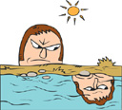
Master Key System
Part Twenty Two
Spiritual Seeds
Your world of power is within; if you are wise, you will not waste time and effort in trying to deal with effects as you find them in the “world without,” which is only an external reflection.
You will always find the cause in the “world within,” and by changing the cause, you change the effect.
“Your Thoughts = Your Life”

Slide 6



Master Key System
Part Twenty Two
Spiritual Seeds
Every element of your body is
the result of a rate of vibration.
Mental action is a rate of vibration.
A higher rate of vibration governs,
modifies, controls, changes or
destroys a lower rate of vibration.

Slide 7
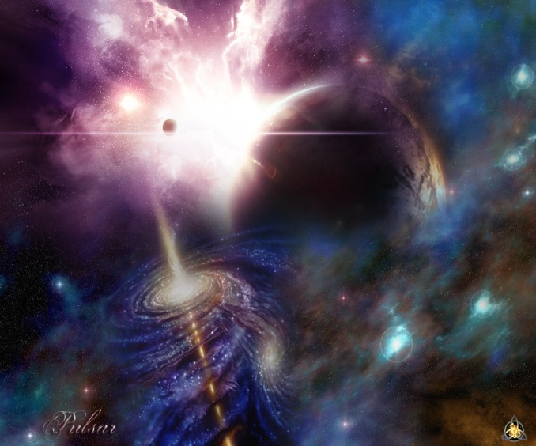
Master Key System
Part Twenty Two
Spiritual Seeds
Everything is a part of the one stupendous whole whose body is nature and God is the soul.
Opportunity follows perception.
Action follows inspiration.
Growth follows knowledge.
Eminence follows progress.
Always the spiritual first, then the transformation into the infinite and illimitable possibilities of achievement.

Slide 8
Part Twenty Two
Main Points
1). Sickness is eliminated by placing yourself in harmony with Natural Law.
2). By realizing that you are a spiritual being and spirit is perfect you can eliminate sickness.
3). First you have to become conscious of your perfection intellectually and emotionally and then you can manifest this perfection.
4). Thought is spiritual and therefore creative which allows it to manifest.
5). The Law of Vibration is brought into operation through this process.

Slide 9
Part Twenty Two
Main Points
6). A higher rate of vibration governs, modifies, controls, changes, or destroys a lower rate of vibration.
7). There are millions of people who make use of this process in one form or another.
8). The result of this way of thinking is demonstrated by mans’ highest reasoning faculties.
9). This system will meet every human requirement or necessity.
10). This system is both scientific and spiritual because true science and spirituality are twin sisters…where one goes the other necessarily follows.

Slide 10
Part Twenty Two
Study Questions
How may sickness be eliminated? By placing yourself in harmony with Natural Law which is Omnipotent.
What is the process? A realization that you are a spiritual being and that this spirit must necessarily be perfect.
What is the result? A conscious recognition of this perfection-first intellectually, then emotionally-brings about a manifestation of this perfection.
Why is this so? Because thought is spiritual and therefore creative and correlates with its object and brings it into manifestation.
What Natural Law is brought into operation? The Law of Vibration.

Slide 11
Part Twenty Two
Study Questions
Why does this govern? Because a higher rate of vibration governs, modifies, controls, changes, or destroys a lower rate of vibration.
Is this system of mental therapeutics generally recognized? Yes, there are literally millions of people in this country who make use of it in one form or another (and obviously many more world-wide).
What is the result of this system of thought? For the first time in the world’s history every man’s highest reasoning faculty can be satisfied by a demonstrable truth which is now fast flooding the world.
Is this system applicable to other forms of supply? It will meet every human requirement or necessity.
Is this system scientific or religious? Both. True science and true religion are twin sisters, where one goes, the other necessarily follows.

