Slide 1



Master Key System
Part Twenty One
“To Think Big Thoughts”
Presented
by
Dr. Peter C. Rogers, D.D., PhD.

Slide 2

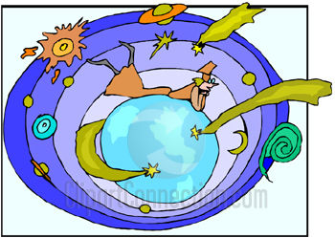

Master Key System
Part Twenty One
To Think Big Thoughts
You will find that everything you hold in your consciousness for any length of time becomes impressed upon your subconscious which becomes a pattern that the creative energy will wave into your life and environment.

Slide 3
Master Key System
Part Twenty One
To Think Big Thoughts
The Infinite Mind is the source from which all things proceed
You are the channel whereby the eternal energy is manifested.
Your ability to think is your ability to act upon this Universal substance.
What you think is what is created or produced in the objective world.

Slide 4

Master Key System
Part Twenty One
To Think Big Thoughts
Your life is simply the reflection of your predominant thoughts your mental attitude.
Correct thinking is a science.
Your thoughts create an impression on your brain which become your mental tendencies.
Tendencies create character, ability, purpose and determine the experiences with which you shall meet in life.
If you can change your thoughts, you can change your life.

Slide 5


Master Key System
Part Twenty One
To Think Big Thoughts
Your mental attitude is patterned after the mental pictures which have been photographed on your brain.
If you do not like the pictures, destroy the negatives and create new pictures through visualization.
You will begin
to have new
pictures that
will ultimately
attract new things.

Slide 6
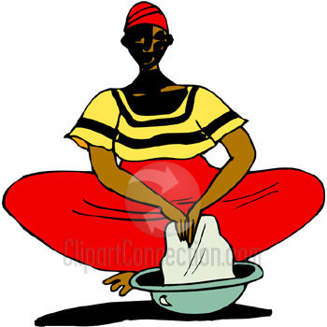
Master Key System
Part Twenty One
To Think Big Thoughts
There is no limit to what this law can do for you.
Dare to believe in your own idea.
Nature is plastic to your ideal.
Think of it as an already accomplished fact.
The real battle of life is one of ideas. (Centered in thinking)

Slide 7
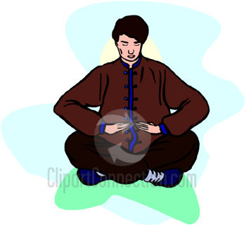


Master Key System
Part Twenty One
To Think Big Thoughts
As long as you regard the Cosmic power as non-human or alien, you will continue to be ruled by a supposed privileged class.
The real interest of democracy is to recognize the divinity of the human spirit.
All power is from within and no one has any more power than any other.

Slide 8


Master Key System
Part Twenty One
To Think Big Thoughts
Divine Mind is no respecter of persons.
It does not anger,
it is not jealous
or wrathful and it
cannot be flattered,
cajoled or moved by
sympathy or petition.
Although as you align
yourself with Divine
Mind you will feel favored.

Slide 9
Master Key System
Part Twenty One
To Think Big Thoughts
Every thought creates an impression on your brain.
Experiences come to you through the Law of Attraction.
Your predominant thought or mental attitude is the magnet.
Like attracts like.
Your mental attitude is your personality and it is composed of all the thoughts that you have been creating in your mind.
Through persistent effort, you can change your mental attitude.
To do this, replace your mental pictures with new ones.
Your new pictures will begin to attract those things.
Incorporate determination, ability, talent, courage and power into your new pictures.
Aspire to the highest possible attainment in anything you do.
Repeat this process as repetition builds habit.

Slide 10
Part Twenty One
Main Points
The real secret of power is consciousness of power.
The source of this power is the Universal Mind from which all things proceed.
You are the channel whereby this energy is being differentiated in form.
Your ability to think is your ability to act on this Universal energy.
You can eliminate imperfect conditions by becoming conscious of your unity with the source of all power.

Slide 11
Part Twenty One
Main Points
A distinctive characteristic of the Master Mind is that you “Think Big Thoughts.”
Experience comes to you through the Law of Attraction.
Your predominant mental attitude brings this law into operation.
The old regime is trying to cling to the doctrine of Divine election.
The new regime recognizes the Divinity of the individual and the democracy of humanity.

Slide 12
Part Twenty One
Study Questions
What is the real secret of power? The consciousness of power, because whatever you become conscious of, is invariably manifested in the objective world, and is brought forth into tangible expression.
What is the source of this power? The Universal Mind from which all things proceed and which is one and indivisible.
How is this power being manifested? Through the individual. Each individual is a channel whereby this energy is being differentiated in form.
How may we connect with this Omnipotence? Your ability to think is your ability to act on this Universal energy and what you think is what is produced or created in the objective world.
What is the result of this discovery? The result is nothing less than marvelous because it opens unprecedented and limitless opportunity.

Slide 13
Part Twenty One
Study Questions
How then may you eliminate imperfect conditions? By becoming conscious of your unity with the source of all power.
What is one of the distinctive characteristics of the Master Mind? He thinks big thoughts, he holds ideas large enough to counteract and destroy all petty and annoying obstacles.
How do experiences come to you? Through the Law of Attraction.
How is this law brought into operation? By your Predominant Mental Attitude. (PMA)
What is the issue between the old regime and the new? A question of conviction as to the nature of the Universe. The old regime is trying to cling to the fatalistic doctrine of Divine election. The new regime recognizes the Divinity of the individual, the democracy of humanity.

