Slide 1

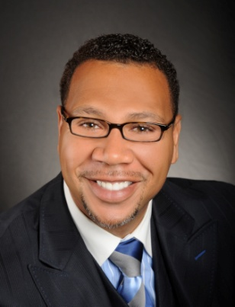

Master Key System
Part Twenty Four
“Alchemy”
Presented
by
Dr. Peter C. Rogers, D.D., PhD.

Slide 2

Master Key System
Part Twenty Four
Alchemy
The Truth will set you free from lack, limitation, sorrow, worry and care.
The Law (God) is no respecter of persons.
Gold in the Mind may be transmuted into gold in the heart and in the hand.

Slide 3
Master Key System
Part Twenty Four
Alchemy
Light is the only thing we can really see. It comes to us in the form of a combination of magnetic and electrical energy traveling at very high speeds. Light is composed of small particles of energy called photons. Light travels in waves that progress as straight lines. The light waves bounce or bend as they travel. The result is reflection or refraction. Different wavelengths produce different colors. Without light, color would not be possible.
Visual light is the combination of seven wavelengths. We cannot see these wavelengths separately, but instead see a combination of the seven that represent white light. The more sensitive the eye is to varying sizes of wavelengths, the more colors can be seen. Visible light, that can be seen by the human eye, ranges between ultraviolet and infrared. They include (from shortest to longest wavelength): violet, indigo, blue, green, yellow, orange, and red. These seven colors are represented in the rainbow. The rain has separated the colors for us to see all seven. These colors also can be seen by shining white light through a glass prism. It is estimated that the human eye can see as many as 150 different hues or shades of color. The color seen depends on the wavelengths the eye can absorb and how you perceive it.
When light strikes either the rods or the cones of the retina, it's converted into an electric signal that is relayed to the brain via the optic nerve. The brain then translates the electrical signals into the images we see.

Slide 4
Master Key System
Part Twenty Four
Alchemy
All conditions are thought creations and entirely mental.
Disease and lack are simply mental conditions where the person fails to perceive the truth.
As soon as the error is removed; the condition is removed.

Slide 5
Master Key System
Part Twenty Four
Alchemy
You have no patient but yourself.
It all starts with you and ends with you.
You have nothing to do but convince yourself of the Truth which you desire to see manifested.

Slide 6


Master Key System
Part Twenty Four
Alchemy
Spirit is the ONLY reality and it can never be less than perfect.
All thought is a form of energy; a rate of vibration.
A thought of Truth (Love) is the highest rate of vibration known.
Truth destroys error just like light destroys darkness.
Truth is Absolute.

Slide 7

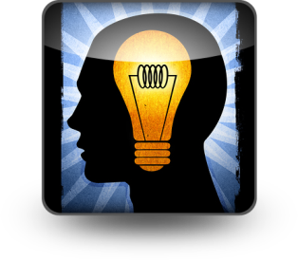
Master Key System
Part Twenty Four
Alchemy
Your environment and circumstances already exist in your subconscious personality which attracts to itself the mental and physical material of the same nature.
Your future is being determined from your present…and your present has been determined by your past thoughts, ideals and actions.
You must look within for the cause and try to discover the nature of your life.

Slide 8

Master Key System
Part Twenty Four
Alchemy
God is the Universal creative principle.
God is not outside of you. It is your very life.
The minute the Spirit leaves your body, you cease to exist.
Spirit is all there is!

Slide 9
Master Key System
Part Twenty Four
Alchemy
“Knowledge pours into our lives from every corner…Fill you glass with it.”
“You now have within your possession The Master Key. There are no longer any secrets or mysteries, there is merely the fact that you must realize your possession of the Key and take it.”
“Everything is possible. With your mind and your thinking, you can dream any dream and have it become reality.”

Slide 10
Part Twenty Four
Main Points
The theory and practice of Metaphysics depend upon knowledge of the Truth.
The truth concerning yourself is that the “I” is spiritual and can never be less than perfect.
To destroy error you must convince yourself of the Truth you wish to see manifested.
We live and move and have our being in the Universal Mind.
The Universal Mind is the totality of all mind in existence.

Slide 11
Part Twenty Four
Main Points
The Universal Mind is omnipresent. There is no place that it is not. It exist inside of us.
The nature of the Universal Mind is that it is spiritual and it seeks to express itself in form.
Your ability to think is your ability to act on the Universal Mind.
Thinking is clear, decisive, calm, deliberate and sustained thought with a definite end in view.
The result is that you will be able to say “It is (God) the Universal Mind that dwells in me that does the work.”

Slide 12
Part Twenty Four
Study Questions
Upon what principle does the theory and practice of every system of Metaphysics in existence depend? Upon a knowledge of the “Truth” concerning yourself and the world in which you live.
What is the “Truth” concerning yourself? The real “I” or ego is spiritual and can therefore never be less than perfect.
What is the method of destroying any form of error? To absolutely convince yourself of the “Truth” concerning the condition which you wish to see manifested.
Can we do this for others? The Universal Mind in which “we live and move and have our being” is one and indivisible, it is therefore just as possible to help others as to help ourselves.
What is the Universal Mind? The totality of all mind in existence.

Slide 13
Part Twenty Four
Study Questions
Where is the Universal Mind? The Universal Mind is omnipresent, it exists everywhere. There is no place where it is not. It is therefore within us. It is “The World within.” It is our spirit, our life.
What is the nature of the Universal Mind? It is spiritual and consequently creative. It seeks to express itself in form.
How may we act on the Universal Mind? Our ability to think is our ability to act on the Universal Mind and bring it into manifestation for the benefit of ourselves or others.
What is meant by thinking? Clear, decisive, calm, deliberate, sustained thought with a definite end in view.
What will be the result? You will be able to say, “It is not I that doeth the works, but God that dwelleth within me that doeth the work. You will come to know that God is the Universal Mind and that God does really and truly dwell within you.

