Slide 1

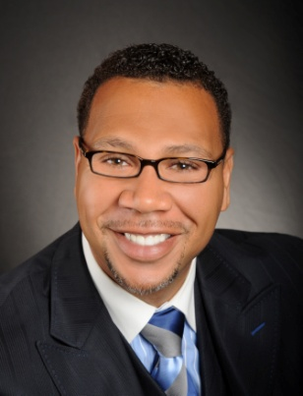

Master Key System
Part Twelve
“The Power of Concentration”
Presented
by
Dr. Peter C. Rogers, D.D., PhD.

Slide 2
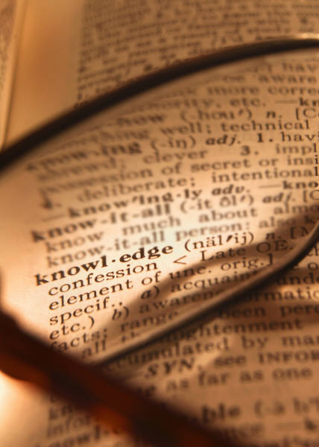



Master Key System
Part Twelve
The Power of Concentration
Knowledge does not apply itself; you must make the application which consists in fertilizing the thought with a living purpose.
It is only through understanding and application that it works…

Slide 3



Master Key System
Part Twelve
The Power of Concentration
The three essential steps are
Knowledge
Courage

Slide 4




Master Key System
Part Twelve
The Power of Concentration
Love is the eternal and fundamental
principle inherent in all things.
Thought impregnated with Love
becomes invincible

Slide 5


Master Key System
Part Twelve
The Power of Concentration
The Universal Mind is an attractive substance that brings particles together by way of the
“Law of Attraction”

Slide 6


Master Key System
Part Twelve
The Power of Concentration
Every creation happens twice
Things are created in the mental or spiritual world before they appear in the outward world.
The best way to predict the future is to create it.

Slide 7
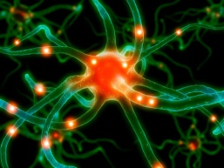
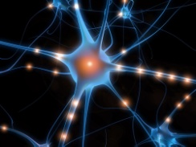

Master Key System
Part Twelve
The Power of Concentration
The mind cannot comprehend an entirely new idea until a corresponding vibratory brain cell has been prepared to receive it. (Spanish Conquerors)
This explains why it is so difficult for you to receive an entirely new idea; you have no brain cell capable of receiving it. (Doubt)
“When the student is ready…the teacher will appear”

Slide 8
Part Twelve
Main Points
Any purpose in life may be accomplished through a scientific understanding of the spiritual nature of thought.
The three steps that are essential are: Knowledge, Courage and Faith.
This Knowledge is secured by an understanding of Natural laws.
The principle which gives thought its dynamic power is the “Law of Attraction” by way of the “Law of Love.”

Slide 9

Part Twelve
Main Points
This law is irresistible because it is a Natural law.
The difficulty in understanding this is because you are uninformed or inexperienced.
It is impossible for your mind to grasp an entirely new idea because you have not formed the corresponding vibratory brain cell.
Wisdom is secured by concentration. It is an unfoldment. It comes from within.

Slide 10

Part Twelve
Study Questions
How may any purpose in life be best accomplished? Through a scientific understanding of the spiritual nature of thought.
What three steps are absolutely essential? The Knowledge of your power, the Courage to dare, the Faith to do.
How is the practical working knowledge secured? By an understanding of Natural laws.
What is the reward of an understanding of these laws? A conscious realization of our ability to adjust ourselves to Divine and unchanging principle.
What will indicate the degree of success with which you meet? The degree in which you realize that you cannot change the Infinite but must cooperate with it.

Slide 11

Part Twelve
Study Questions
What is the principle which gives thought its dynamic power? The Law of Attraction which rests on vibration, which in turn rests upon the Law of Love. Thought impregnated with Love becomes invincible.
Why is this law irresistible? Because it is a Natural law. All Natural laws are irresistible and unchangeable and act with mathematical exactitude. There is no deviation or variation.
Why then does it sometimes seem to be difficult to find the solution to your problems in life? For the same reason that it is sometimes difficult to find the correct solution to a difficult mathematical problem. You are uninformed or inexperienced.
Why is it impossible for the mind to grasp an entirely new idea? You have no corresponding vibratory brain cell capable of receiving the idea.
How is wisdom secured? By concentration; it is an unfoldment; it comes from within.

