Slide 1

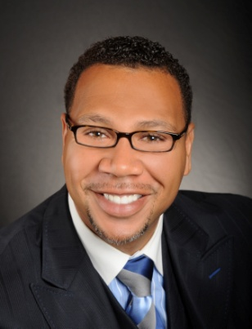

Master Key System
Part Three
“Realizing Your Mental Resources”
Presented
by
Dr. Peter C. Rogers, D.D., PhD.

Slide 2
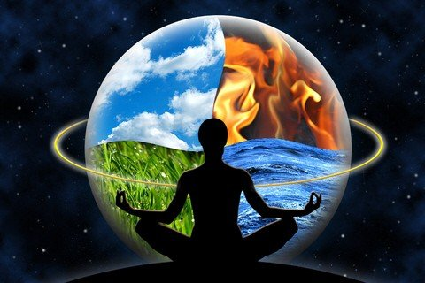

Master Key System
Part Three
Realizing Your Mental Resources
Thought is the Cause, and the experiences with which you meet in life are the Effect.
-----------------------------
Cause---------------------------------------------------------Effect

Slide 3

Master Key System
Part Three
Realizing Your Mental Resource
Cerebro-Spinal = Conscious Mind
Physical senses, controls movements over the body)
|
|
|
|
|
|
|

Slide 4
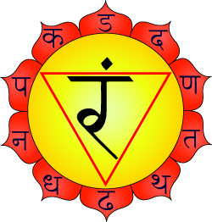

Master Key System
Part Three
Realizing Your Mental Resources
The Sympathetic System = Solar Plexus
Solar/Sun
“Manipura”
Unconsciously supports the vital functions of the body

Slide 5
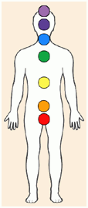
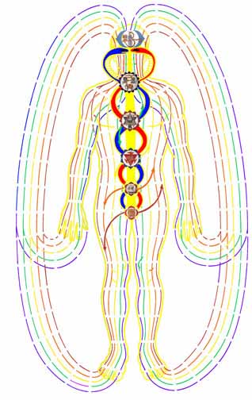
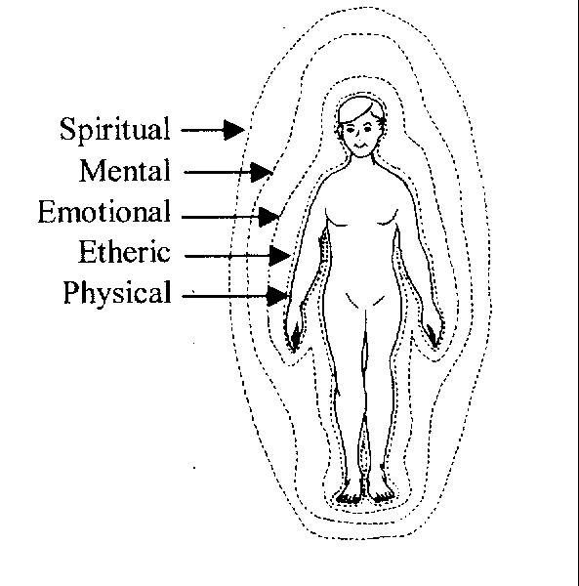

Master Key System
Part Three
Realizing Your Mental Resources
Human Energy Field (HEF)-Chakras
-------------------------------------------

Slide 6

Master Key System
Part Three
Realizing Your Mental Resources
Life is only 10% of what happens and the other 90% is how I respond.
My Wage
“I bargained with life for a penny, and life would pay no more, however I begged at evening when I counted my scanty store.
For life is a just employer, he gives you what you ask, but once you have set the wages, why you must bear the task.
I worked for a menial’s hire, only to learn dismayed, that any wage I had asked of life, life would have willingly paid…” Jessie B. Rittenhouse

Slide 7

Master Key System
Part Three
Realizing Your Mental Resources
Mentally concentrate on the object of your desire; when you are concentrating you are impressing the subconscious.
The Subconscious Mind is a part of the Universal Mind. The Universal is the creative principle of the Universe.

Slide 8

Part Three
Main Points
The Cerebro-spinal is the organ of the Conscious Mind.
The Sympathetic is the organ of the Subconscious Mind.
The Solar Plexus is the central point of distribution for the energy which the body is constantly generating.
The distribution of energy may be disrupted by resistant, critical, discordant thoughts; but especially by “fear.”
Every ill with which the human race is afflicted is the result of this disruption.

Slide 9

Part Three
Main Points
This energy may be controlled and directed by conscious thought.
Fear may be completely eliminated by an understanding and recognition of the true source of all power.
Our Predominant Mental Attitude (PMA) determines the experiences with which we meet in life. (10% - 90%)
To awaken the Solar Plexus, mentally concentrate upon the condition that you desire to see manifested in your life.
The Universal Mind is the creative principle of the Universe.

Slide 10

Part Three
Study Questions
What system of nerves is the organ of the Conscious Mind? The Cerebro-spinal.
What system of nerves is the organ of the Subconscious Mind? The Sympathetic.
What is the central point of distribution for energy which the body is constantly generating? The Solar Plexus.
How may this distribution be interrupted? By resistant, critical, discordant thoughts, but especially fear.
What is the result of such interruption? Every ill with which the human race is afflicted.

Slide 11

Part Three
Study Questions
How may this energy be controlled and directed? By conscious thought.
How may fear be completely eliminated? By an understanding and recognition of the true source of all power.
What determines the experiences with which we meet in life? Our Predominant Mental Attitude. (PMA)
How may we awake the Solar Plexus? Mentally concentrate upon the condition with which we desire to see manifested in our lives.
What is the creative principle of the Universe? The Universal Mind.

