Slide 1

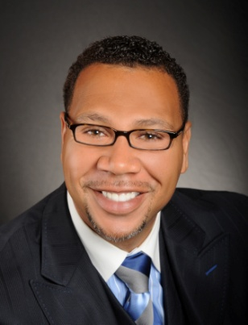

Master Key System
Part Thirteen
“The Dreams of the Dreamer”
Presented
by
Dr. Peter C. Rogers, D.D., PhD.

Slide 2

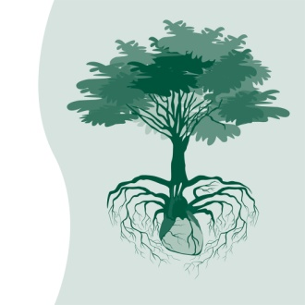

Master Key System
Part Thirteen
The Dreams of The Dreamer
Natural Law
-------- ------- ”Fruition”
-------- ------------- “Thoughts”
You plant seeds with your thoughts that will ultimately germinate as your life

Slide 3




Master Key System
Part Thirteen
The Dreams of The Dreamer
Thoughts will bring about conditions corresponding with a Predominant Mental Attitude (PMA)
“FEAR” “WORRY” “DOUBT”

Slide 4
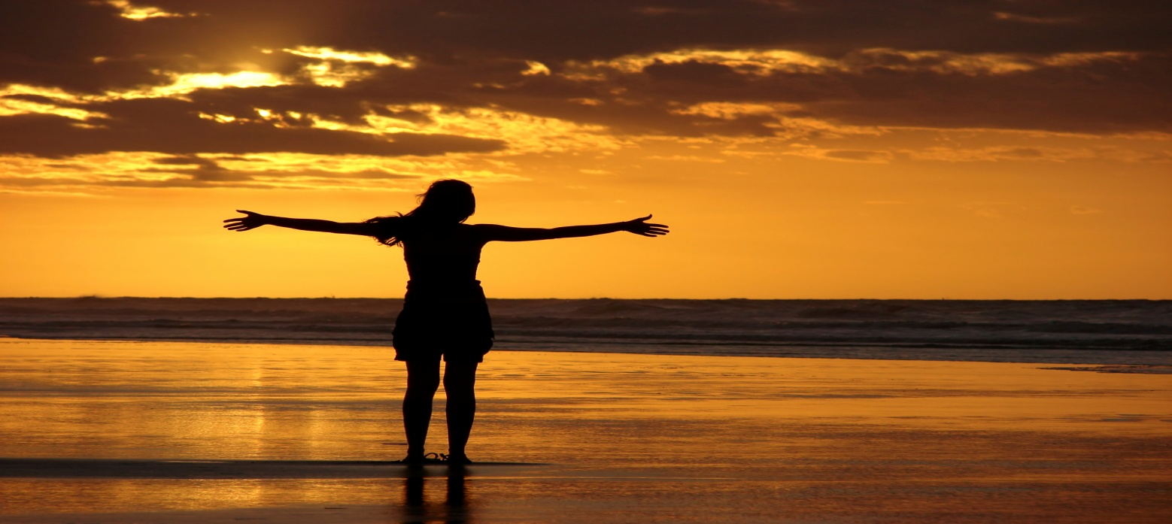

Master Key System
Part Thirteen
The Dreams of The Dreamer
Happiness and Harmony
Be Happy Now…
“I asked for all things that I might enjoy life, but instead, I was given life that I might enjoy all things”

Slide 5

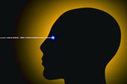

Master Key System
Part Thirteen
The Dreams of The Dreamer
Thought must be Consciously,
Systematically and Constructively directed like a magnifying glass

Slide 6

Master Key System
Part Thirteen
The Dreams of The Dreamer
A happy thought cannot exist in an unhappy conscious
Happy Thought………… ………..Un-Happy Thought
Two things cannot exist in the same place at the same time

Slide 7
Master Key System
Part Thirteen
The Dreams of The Dreamer
In creating a Mental Image, you are projecting a thought into the Universal Substance

Slide 8
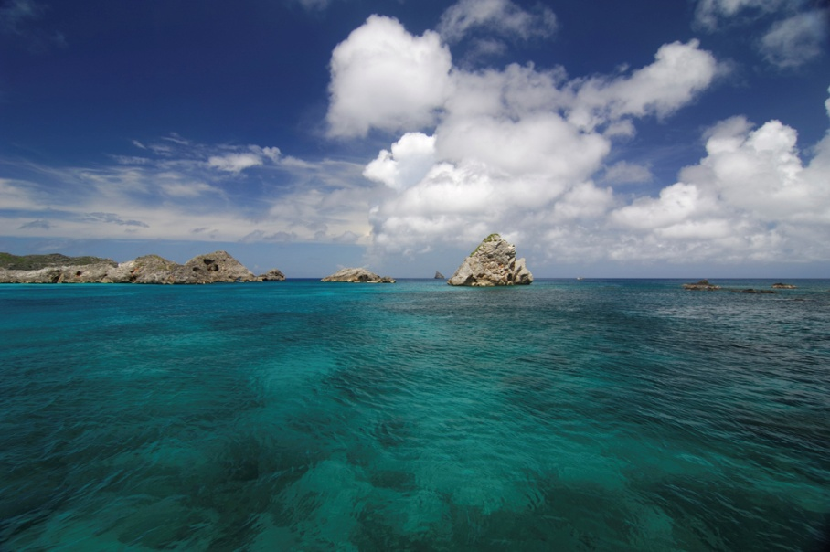

Master Key System
Part Thirteen
The Dreams of The Dreamer
You are part of the Whole which is the same in quality. The only difference is one of degree
“You and God are One and the same”

Slide 9
You are simply the incarnated physical representation of God on this planet. To understand this I must tell you a story.
There was a young religious scholar who had been trained in the best schools, sat at the feet of the master teachers for years and now he was ready to take the last step to become a master himself. In order for him to become a master, he had to go see the old sage. The old sage was one who did not care about money, possessions or social status. He lived on an old run down beach. So the young scholar having heard about the old sage reluctantly went to see him. When he arrived the old sage looked at him and said, look to your right and tell me what do you see? The scholar replied I see the infinite ocean. The sage said very good. Now look to your left, what do you see?
The scholar replied I see a pond of water separated from the infinite ocean. The sage told the scholar to put the pond back into the ocean. The young scholar was incensed at such a request and refused. The old sage told him to leave! The young scholar feeling very confused sat down and contemplated his options. He decided to humble himself, went back to the sage and apologized. After 10 hours of work (putting the pond of water back into the ocean) he went to the sage and said Sir, I am finished. Now give me the information I need to become a master. The old sage said to the young scholar can you find the pond of water that you spent 10 hours of work putting back into the ocean? The scholar replied no, that would be impossible they are made of the same stuff. The sage said well done now you are ready to become a master.

Slide 10

Part Thirteen
Main Points
To observe facts carefully, patiently and accurately is the method that philosophers use to apply knowledge.
We may be certain that this method is correct by not allowing prejudice or neglect.
The facts esteemed most highly cannot be accounted by the use of daily observations.
This principle is based on reason and experience.
This principle destroys superstition, precedent and conventionality.

Slide 11
Part Thirteen
Main Points
These laws are uncommon, rare, strange and exceptional.
The creative power of thought accounts for the strange and unexplained phenomena.
This is because once you learn a fact it becomes a certain definite cause that operates with precision.
This knowledge explains the cause of every condition, whether physical, mental or spiritual.
Your best interest is conserved by recognizing the creative nature of thought which connects you with the Infinite power.

Slide 12
Part Thirteen
Study Questions
What is the method by which natural philosophers obtain and apply their knowledge? To observe individual facts carefully, patiently, accurately, with all the instruments and resources at their command before venturing upon a statement of general laws.
How may we be certain that this method is correct? By not permitting a tyrannical prejudice to neglect or mutilate unwelcome facts.
What class of facts are esteemed most highly? Those which cannot be accounted for by the usual daily observation of life.
Upon what is this principle founded? Upon reason and experience.
What does it destroy? Superstition, precedent and conventionality.

Slide 13

Part Thirteen
Study Question
How have these laws been discovered? By generalization of facts which are uncommon, rare, strange and form the exception.
How may we account for much of the strange and heretofore unexplainable phenomena which is constantly taking place? By the creative power of thought.
Why is this so? Because when you learn of a fact you can be sure that it is the result of a certain definite cause and that this cause will operate with invariable precision.
What is the result of this knowledge? It will explain the cause of every possible condition, whether physical, mental or spiritual.
How will your best interest be conserved? By a recognition of the fact that a knowledge of the creative nature of thought puts you in touch with Infinite power.

