Slide 1

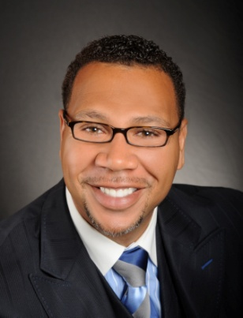

Master Key System
Part Ten
“A Certain Definite Cause”
Presented
by
Dr. Peter C. Rogers, D.D., PhD.

Slide 2



Master Key System
Part Ten
A Certain Definite Cause
Abundance is a natural law of the Universe
                ----------------------------------------
If you’re not living abundantly…you’re breaking the law of the Universe.

Slide 3
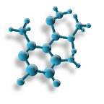
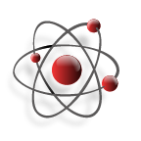

Master Key System
Part Ten
A Certain Definite Cause
Spiritual power is superior because it exists on a higher plane.

Slide 4

Master Key System
Part Ten
A Certain Definite Cause
Thought is the connecting link between the Infinite and the finite, between the Universal and the Individual.
- ------------------------------------------------------------------- +
The Universe is the Positive and you are the negative. If your thought is in harmony with the Creative Principle of nature and it is in tune with the Infinite Mind, then it will form the circuit and it will not return to you void.

Slide 5

Master Key System
Part Ten
A Certain Definite Cause
“Know Thyself”
Socrates
You are all a part of the Universe and the Universe is able to express Itself through you if you allow it. You must act in accordance with Its laws. When you do, the gates will be let open and you will be able to partake in all of Its abundance.

Slide 6

Master Key System
Part Ten
A Certain Definite Cause
You will find that the things you seek are seeking you.
When any object or purpose is clearly held in thought, its precipitation, in tangible and visible form, is merely a question of time.

Slide 7

Part Ten
Main Points
Wealth is the offspring of power.
Possessions are of value only as they confer power.
A knowledge of cause and effect enables you to plan courageously and execute fearlessly.
Life originates in the inorganic world only by the introduction of some living form, there is no other way.

Slide 8

Part Ten
Main Points
Thought is the connecting link between the finite and the infinite because the Universe can only manifest through you.
Causation depends upon polarity. A circuit must be formed. The Universe is the Positive side of the battery, You are the Negative and thought forms the circuit.
Many fail to secure harmonious conditions because they have not formed the circuit.
The remedy is a conscious recognition of the Law of Attraction.
The result is that thought will correlate with its object and bring it into manifestation because thought is a product of the spiritual man and spirit is the Creative Principle of the Universe.

Slide 9

Part Ten
Study Questions
What is wealth? Wealth is the offspring of power.
Of what value are possessions? Possessions are of value only as they confer power.
Of what value is a knowledge of cause and effect? It enables men to plan courageously and execute fearlessly.
How does life originate in the inorganic world? Only by the introduction of some living form. There is no other way.
What is the connecting link between the finite and the infinite? Thought is the connecting link.

Slide 10

Part Ten
Study Questions
Why is that so? Because the Universal can manifest only through the individual.
Upon what does causation depend? Upon polarity; a circuit must be formed; the Universal is the positive side of the batter of life, the individual is the negative, and thought forms the circuit.
Why do many fail to secure harmonious conditions? They do not understand the law; there is no polarity; they have not formed the circuit.
What is the remedy? A conscious recognition of the Law of Attraction with the intention of bringing it into existence for a definite purpose.
What will be the result? Thought will correlate with its object and bring it into manifestation, because thought is a product of the spiritual man, and spirit is the Creative Principle of the Universe.

