Slide 1

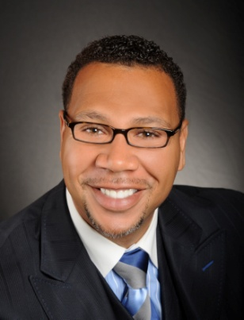

Master Key System
Part Sixteen
“Gaining Spiritual Understanding”
Presented
by
Dr. Peter C. Rogers, D.D., PhD.

Slide 2

Master Key System
Part Sixteen
Gaining Spiritual Understanding
Life is growth and growth is change, each seven year period takes you into a new cycle.
1st Seven Year Period Period of infancy
2nd Seven Year Period Childhood (Responsibility)
3rd Seven Year Period Adolescence
4th Seven Year Period Full Growth
5th Seven Year Period Constructive Period
6th Seven Year Period Reaction and Change
7th Seven Year Period New Cycle

Slide 3



Master Key System
Part Sixteen
Gaining Spiritual Understanding
The most commonly accepted definition of wealth is that it consists of all useful and agreeable things which posses exchange value.
=

Slide 4


Master Key System
Part Sixteen
Gaining Spiritual Understanding
The three spiritual steps to creation are:
Idealization (Think It) 1.
Visualization (See it) 2.
Materialization (Make It) 3.

Slide 5



Master Key System
Part Sixteen
Gaining Spiritual Understanding
The conditions with which you meet in the world without, correspond to the conditions which you find in the world within.
Corresponds
with

Slide 6


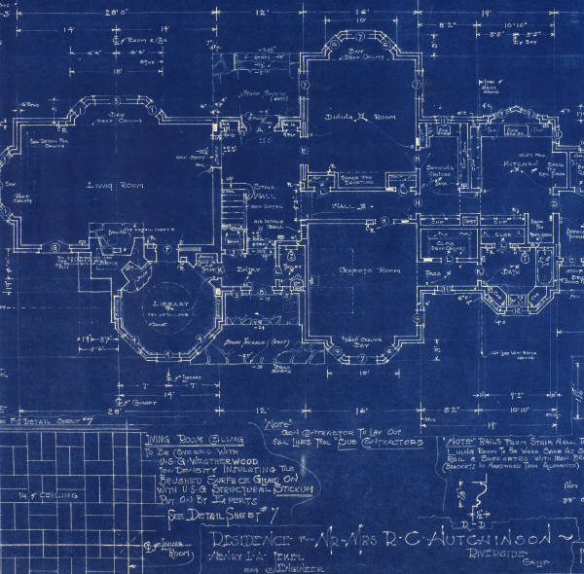

Master Key System
Part Sixteen
Gaining Spiritual Understanding
What you visualize already exist in the spiritual world
Your thoughts and visioning is the blueprint

Slide 7

Part Sixteen
Main Points
Wealth depends upon an understanding of the creative nature of thought.
True value consists of its exchange value.
Success depends upon spiritual power.
Spiritual power depends upon use. Use determines its existence.
You may take your fate out of the hands of chance by consciously realizing the conditions that you desire to see manifested in your life.

Slide 8

Part Sixteen
Main Points
Thinking is the greatest business of life because thought is spiritual and therefore creative. To consciously control thought is therefore to control your circumstances, conditions, environment and destiny.
Destructive thinking is the source of all evil.
Scientific correct thinking is the source of all good.
Scientific thinking is a recognition of the creative nature of spiritual energy and your ability to control it.

Slide 9

Part Sixteen
Study Questions
Upon what does wealth depend? Upon an understanding of the creative nature of thought.
Upon what does its true value consist? Upon its exchange value.
Upon what does success depend? Upon spiritual power.
Upon what does this power depend? Upon use; use determines its existence.
How may you take your fate out of the hands of chance? By consciously realizing the conditions which you desire to see manifested in your life.

Slide 10
Part Sixteen
Study Questions
What then is the business of life? Thinking.
Why is this so? Because thought is spiritual and therefore creative. To consciously control thought is therefore to control your circumstances, conditions, environments and destiny.
What is the source of all evil? Destructive thinking.
What is the source of all good? Scientific correct thinking.
What is scientific thinking? A recognition of the creative nature of spiritual energy and our ability to control it.

