Slide 1



Master Key System
Part Six
“The Brain of Man”
Presented
by
Dr. Peter C. Rogers, D.D., PhD.

Slide 2
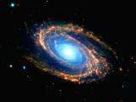
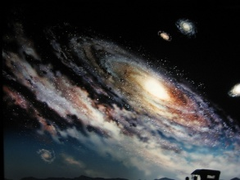


Master Key System
Part Six
The Brain of Man
The process of evolution is constantly building your tomorrows out of your todays.
Your individual development
like Universal development
must be gradual with an
ever increasing capacity
and volume. (Expanding Universe)
The greatest good to the greatest number. (Summum Bonum)

Slide 3


Master Key System
Part Six
The Brain of Man
Electricity is a form of motion and its effects depend upon the mechanism to which it is attached. ( Heat, Light, power)
Thought is mind in motion and its effects will depend entirely upon the “mechanism to which it is attached.”
Here then, is the secret of all mental power; it depends entirely upon the mechanism which you attach.

Slide 4

Master Key System
Part Six
The Brain of Man
There is the great world in which you live and move and have your being. (Omnipotent, Omniscient, Omnipresent)
It will respond to your desire in direct ratio to your purpose and faith.
Your purpose must in accordance with the law of your being. (Creative or Constructive)
Your faith must be strong enough to generate a current of sufficient strength in order to manifest your ideas.
“As thy faith is, so be it unto thee”

Slide 5
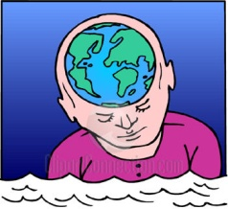
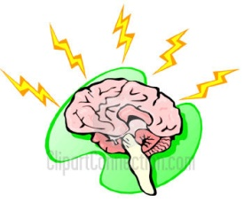

Master Key System
Part Six
The Brain of Man
The effects which are produced in the world without are the result of your action and reaction upon the Universal.
This is based on your thinking.
Every beauty to which you
respond must have its cor-
responding outline in your brain
before you can appreciate it
or dislike it. (Spot it, you got it)

Slide 6
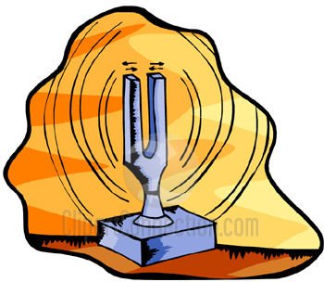
Master Key System
Part Six
The Brain of Man
You are the temple of the
living God.
The man who looks within
instead of without cannot
fail to make use of the mighty
forces which will eventually
determine his course in life.
This will bring you into
vibration with all that
is best, strongest and most desirable.

Slide 7



Master Key System
Part Six
The Brain of Man
Attention, Concentration
and Focus are essential to
developing your mind.
Attention is the distinguishing
characteristic of every successful
man or woman.
Attention can be more readily
understood by comparing it with a
magnifying glass.

Slide 8

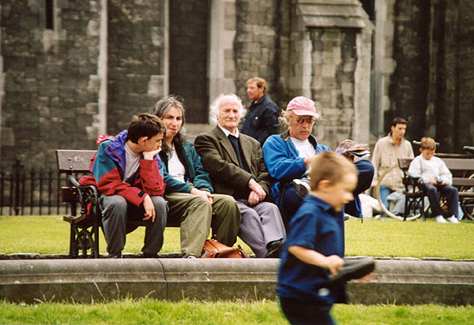




Master Key System
Part Six
The Brain of Man
Picture 1 Picture 2 Picture 3
Picture 4 Picture 5 Picture 6

Slide 9
Part Six
Main Points
Heat, light, power and music are some of the effects that can be produced by electricity.
These effects depend upon the mechanism to which the electricity is attached.
The result of action and interaction from your mind upon the Universal, conditions the experiences with which you meet.
These conditions may be changed by changing the mechanism by which the Universal is differentiated in form.
This mechanism is your brain.

Slide 10
Part Six
Main Points
Your brain may be changed by the process of thinking. Your thoughts produce brain cells which respond to the corresponding thought of the Universal.
The power of concentration is the very highest personal accomplishment that distinguishes every successful person.
This power may be acquired by faithfully practicing this system.
Concentration will enable you to control your thoughts which will ultimately control your effects.
People practicing constructive thinking are changing conditions and multiplying results in the objective world.

Slide 11
Part Six
Study Questions
What are some of the effects which can be produced by electricity? Heat, light, power, music.
Upon what do these various effects depend? Upon the mechanism to which electricity is attached.
What is the result of the action and interaction of your mind upon the Universal? The conditions and experiences with which you meet.
How may these conditions be changed? By changing the mechanism by which the Universal is differentiated into form.
What is this mechanism? The Brain.

Slide 12
Part Six
Study Questions
How may it be changed? By the process of thinking. Thoughts produce brain cells and these cells respond to the corresponding thought in the Universal.
Of what value is the power of concentration? It is the very highest personal accomplishment which can be acquired and the distinguishing characteristic of every successful man or woman.
How may it be acquired? By faithfully practicing the exercises in this system.
Why is this so important? Because it will enable you to control your thoughts, and since thoughts are causes, conditions must be effects; if you can control the cause, you can also control the effect.
What is changing conditions and multiplying results in the objective world? People are learning the basic methods of constructive thinking.

