Slide 1

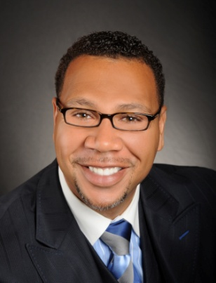

Master Key System
Part Seven
“Utilizing The Omnipotent Power”
Presented
by
Dr. Peter C. Rogers, D.D., PhD.

Slide 2






Master Key System
Part Seven
Utilizing The Omnipotent Power
The Objective is the physical, visible and personal which is recognized by the five senses. (Body, brain and nerves)
The Subjective is the spiritual, the invisible, the impersonal.

Slide 3
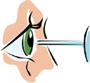

Master Key System
Part Seven
Utilizing The Omnipotent Power
Visualization is the process of making mental images.
The images are the mold or model which will serve as a pattern from which your future will emerge.

Slide 4


Master Key System
Part Seven
Utilizing The Omnipotent Power
The three steps to creation are:
Idealization - Think It (Most important)
Visualization - See It
Materialization - Create It

Slide 5


Master Key System
Part Seven
Utilizing The Omnipotent Power
Clearness and accuracy are obtained only by repeatedly having the image in mind.
Each repeated action renders the image more clear and accurate than before.
The outward manifestation will be proportionate to the clearness and accuracy of your image.

Slide 6
Master Key System
Part Seven
Utilizing The Omnipotent Power
Earnest Desire will bring about Confident Expectation which will be reinforced by Firm Demand.
Earnest Desire = Feeling/Vitality
Confident Expectation = Thought
Firm Demand = Will/Steady

Slide 7
Master Key System
Part Seven
Utilizing The Omnipotent Power
You’ve been taught to look “outside” yourself for strength and power.
You’ve been taught to look everywhere but “within.”
You’ve been taught that this power is something supernatural.

Slide 8
Master Key System
Part Seven
Utilizing The Omnipotent Power
Create ideals only!
Don’t think about external conditions.
Make your inner world beautiful and the outer world will express and manifest your inner condition.
Once you realize your power to create ideals you can project them into the world of effect.

Slide 9
Part Seven
Main Points
Visualization is the process of making mental pictures.
This method allows you to gradually bring things into your life. “You can be what you will to be.”
Idealization is the process of visualizing the plans you want to materialize.
Clearness and accuracy are necessary because “seeing” creates “feeling” and “feeling” creates “being.”
Each repeated action renders the image more accurate than before.

Slide 10
Part Seven
Main Points
The material for securing and constructing your mental image is carried out by millions of brain cells.
The Law of Attraction is the method that brings about all conditions and experiences in the objective world.
The three steps necessary are (1) Earnest Desire; (2) Confident Expectation; (3) Firm Demand.
Many fail because they concentrate on loss, disease and disaster only bringing the things they fear upon them.
Only concentrate on what you want not on what you don’t want.

Slide 11
Part Seven
Study Questions
What is Visualization? The process of making mental pictures.
What is the result of this method of thought? By holding the image or picture in mind, you can gradually but surely bring the thing nearer to you. “You can be what you will to be.”
What is Idealization? It is a process of visualizing or idealizing the plans which will eventually materialize in your object world.
Why are clearness and accuracy necessary? Because “seeing” creates “feeling” and “feeling” creates “being.” First the mental, then the emotional, then the illimitable possibilities of achievement.
How are they obtained? Each repeated action renders the image more accurate than the former one.

Slide 12
Part Seven
Study Questions
How is the material for the construction of your mental image secured? By millions of mental workers called brain cells.
How are the necessary conditions for bringing about the materialization of your ideal in the objective world secured? By the Law of Attraction. The natural law by which all conditions and experiences are brought about.
What three steps are necessary in order to bring this law into operation? Earnest Desire, Confident Expectation, Firm Demand.
Why do many fail? Because they concentrate on loss, disease and disaster. The law is operating perfectly; the things they fear are coming upon them.
What is the alternative? Concentrate on the ideals which you desire to see manifested in your life.

