Slide 1



Master Key System
Part Nineteen
“Your Mental Food”
Presented
by
Dr. Peter C. Rogers, D.D., PhD.

Slide 2


Master Key System
Part Nineteen
Your Mental Food
Fear is a powerful form of thought
The way to overcome fear is to become conscious of power

Slide 3

Master Key System
Part Nineteen
Your Mental Food
Method to Eliminate Fear
Take a deep breath in while expanding your abdomen to the limit. (Hold this breath for a second or two)
While holding the breath, draw in more air and carry it to the upper chest drawing in your abdomen. (Hold this breath for a second or two)
Now, deflate the chest and expand the abdomen again. (Don’t exhale)
Alternately expand your abdomen and chest rapidly four or five times
Then exhale.

Slide 4
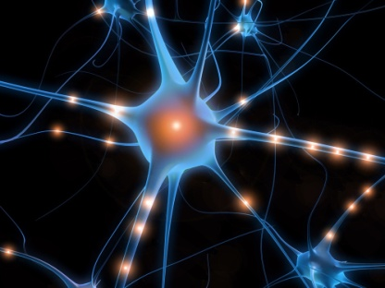
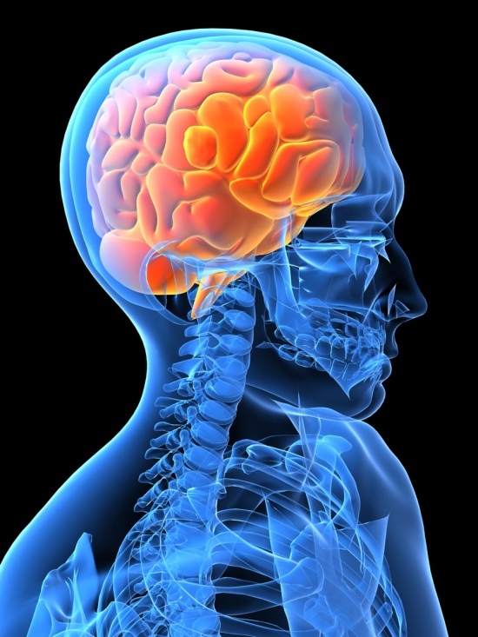

Master Key System
Part Nineteen
Your Mental Food
Every human experience is an effect and since your thought is the cause, you can consciously control the effect.

Slide 5
Master Key System
Part Nineteen
Your Mental Food
The two extremes are relative; they are not separated entities, but they are two parts or aspects of the whole.
Up
North Pole and South Pole
Left and Right Whole
Good and Bad
Left Middle Right
Up and Down Good Bad
They are names given to two different parts of one quantity Down

Slide 6

Master Key System
Part Nineteen
Your Mental Food
If your thought is powerful, constructive and positive, it will be evident in your health, your business and your environment.
If your thought is weak, critical, destructive and negative, it will manifest in your body as fear worry and nervousness and if will also manifest as lack, limitation and discord in your environment.

Slide 7
Master Key System
Part Nineteen
Your Mental Food
This power is superior because it exists on a higher plane
(Hz)
5. Spiritual Level ……………… Universe, God, Energy
4. Mental Level ……………….. Thought, Vibration, Force
3. Emotional Level …………… Moods, Feelings, Tones
2. Etheric Level ……………….. Light, Fine, Subtle
1. Physical Level ………………. Body, Matter, Nature

Slide 8
Part Nineteen
Main Points
Extremes are designated by distinctive names such as inside and outside, top and bottom, light and dark, good and bad.
They are not separate entities. The are parts or aspects of one whole.
The Universal Mind is the one creative principle in the physical, mental and spiritual world.
You are related to this creative principle by your ability to think.
This creative principle is operated by thought. Thought is the seed which results in action and action results in form.

Slide 9
Part Nineteen
Main Points
Form depends upon the rate of vibration.
The rate of vibration may be changed by mental action.
Mental action depends upon polarity, action and reaction between you and the Universal.
The creative energy originates in the Universal and the Universal can only manifest through you.
You are necessary because the Universal is static and requires energy to start it in motion. Food becomes energy that enables you to think. Without food, you stop thinking and the Universal becomes Mind at rest.

Slide 10
Part Nineteen
Study Questions
How are extremes placed in contrast? They are designated by distinctive names, such as inside and outside, top and bottom, light and dark, good and bad.
Are these separate entities? No, they are parts or aspects of one whole.
What is the one creative principle in the physical, mental and spiritual world? The Universal Mind, or the Eternal Energy from which all things proceed.
How are you related to this creative principle? By your ability to think.
How does this creative principle become operative? Thought is the seed which results in action and action results in form.

Slide 11
Part Nineteen
Study Questions
Upon what does form depend? Upon the rate of vibration.
How may the rate of vibration be changed? By mental action.
Upon what does mental action depend? Upon polarity, action and reaction between you and the Universal.
Does the creative energy originate in you or the Universal? In the Universal but the Universal can manifest only through you.
Why are you necessary? Because the Universal is static, and requires energy to start it in motion. This is furnished by food which is converted into energy, which in turn enables you to think. When you stop eating, you stop thinking; then you no longer act upon the Universal and there is no longer any action or reaction; the Universal is then only pure mind in static form—mind at rest.

