Slide 1

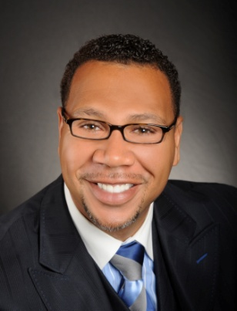

Master Key System
Part Nine
“Affirmations and Your Mind”
Presented
by
Dr. Peter C. Rogers, D.D., PhD.

Slide 2



Master Key System
Part Nine
Affirmations and Your Mind
If you wish to change conditions you must change yourself. Your innermost thoughts will find expression just as certainly as the plant springs from the seed.
Hold in mind the condition desired; affirm it as an already existing fact. “Therefore I say unto you, What things soever ye desire, when ye pray, believe that ye receive [them], and ye shall have [them].”
Positive thoughts destroy negative thoughts just as certainly as light destroys darkness.

Slide 3
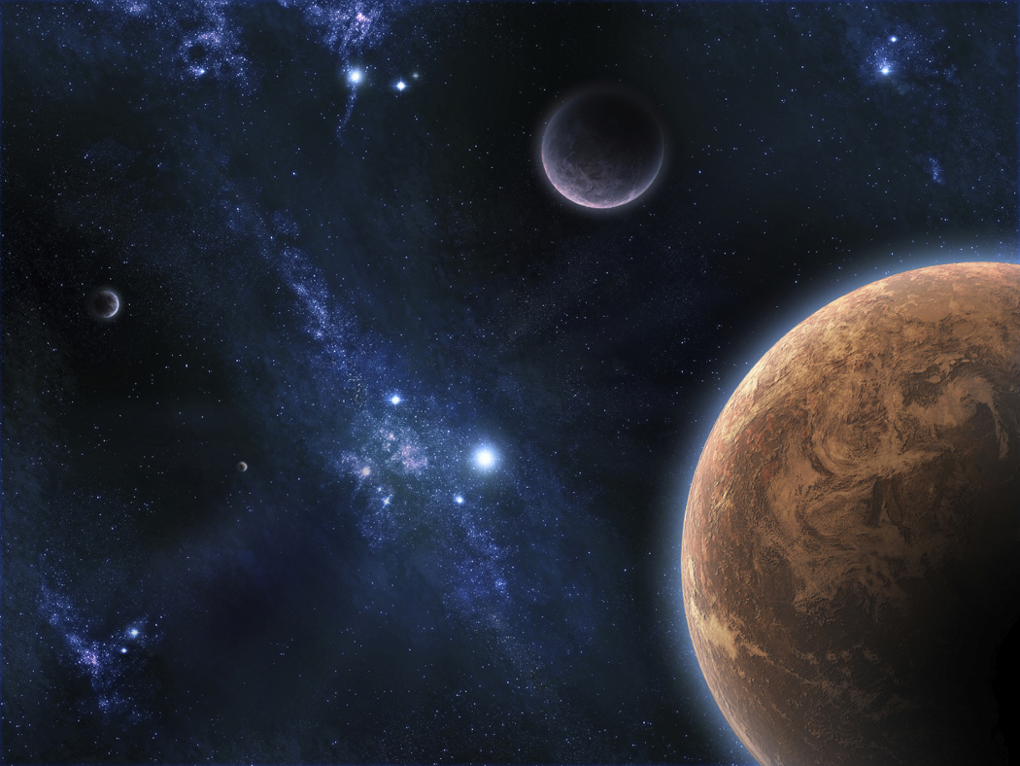
Master Key System
Part Nine
Affirmations and Your Mind
To know the Truth is to be in harmony with Infinite and Omnipotent power. To know the Truth is, therefore, to connect yourself with a power which is irresistible and which will sweep away every kind of discord, inharmony, doubt or error of any kind, because the “Truth is might and will prevail.”

Slide 4


Master Key System
Part Nine
Affirmations and Your Mind
The affirmation: “I am Whole, Perfect, Strong, Powerful, Loving Harmonious and Happy,” will bring about harmonious conditions. This affirmation is in strict accordance with the Truth and when Truth appears, every form of error or discord must necessarily disappear.

Slide 5
Master Key System
Part Nine
Affirmations and Your Mind
Thought is a spiritual activity and spirit is creative, therefore the result of holding a thought in mind, must necessarily bring about conditions in harmony with the thought.
The “I” in you is one with the Universal Mind which is all substance, and is it is Omnipotent. The Universal Mind will assist you in bringing into operation the Law Of Attraction (LOA) which will bring you into vibration with those forces which make for success and bring about conditions of power and affluence in direct proportion with the character and purpose of your affirmation.

Slide 6
Master Key System
Part Nine
Affirmations and Your Mind
Visualization is a different process from seeing; seeing is physical and is therefore related to the objective world, the “world without,” but Visualization is a product of the imagination: (Image-in) and is therefore a product of the subjective mind, the “world within.” It therefore possesses vitality; it will grow.
The thing visualized will manifest itself in form.

Slide 7


Master Key System
Part Nine
Affirmations and Your Mind
Whatever you desire for yourself, affirm it for others and it will help you both.
You reap what you sow.
If you send out thoughts of Love and Health, they return to you like bread cast upon the waters; but if you send out thoughts of Fear, Worry, Jealousy, Anger, Hate, etc., you will reap the results in your own life.

Slide 8

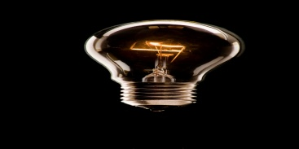



Master Key System
Part Nine
Affirmations and Your Mind
Whenever a thought of Anger, Jealously, Fear or Worry creeps in, start affirming the positive.
The way to fight Darkness is with Light.
The way to fight Cold is with Heat.
The way to overcome Evil is with good.
Affirm the good, and the bad will vanish.

Slide 9
Part Nine
Main Points
Well-doing is the imperative condition of all well-being.
Right thinking is the condition precedent to every right action.
To know the Truth is the underlying condition.
The result of knowing the truth enables you to foretell the results of actions based on true premises.
You cannot foretell the results when actions are based on false premises.

Slide 10
Part Nine
Main Points
You may know the truth by realizing that truth is the vital principle of the Universe and is therefore omnipresent.
The nature of Truth is Spiritual.
The solution to every problem is to apply Spiritual Truth.
The advantage of spiritual methods is that they are always available.
The only requirement for utilizing this method is to recognize the omnipotence of Spirit and then become its recipient.

Slide 11
Part Nine
Study Questions
What is the imperative condition of all well-being? Well doing.
What is the condition precedent to every right action? Right Thinking.
What is the underlying condition necessary in every business transaction or social relation? To know the Truth.
What is the result of a knowledge of the Truth? You can readily predict the result of any action that is based upon a true premise.
What is the result of any action based upon a false premise? You can form no conception of the results which may ensue.

Slide 12
Part Nine
Study Questions
How may we know the Truth? By a realization of the fact that Truth is the vital principle of the Universe and is therefore omnipresent.
What is the nature of Truth? It is Spiritual.
What is the secret of the solution to every problem? To apply Spiritual Truth.
What is the advantage of Spiritual methods? They are always available.
What are the necessary requirements? A recognition of the omnipotence of the Spiritual power and a desire to become the recipient of its beneficent effects.

