Slide 1

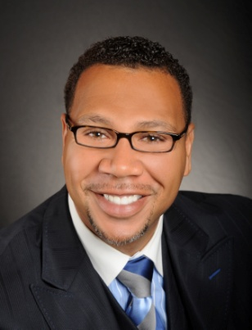

Master Key System
Part Fourteen
“The Creative Power of Thought”
Presented
by
Dr. Peter C. Rogers, D.D., PhD.

Slide 2
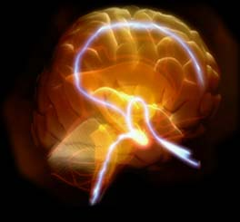
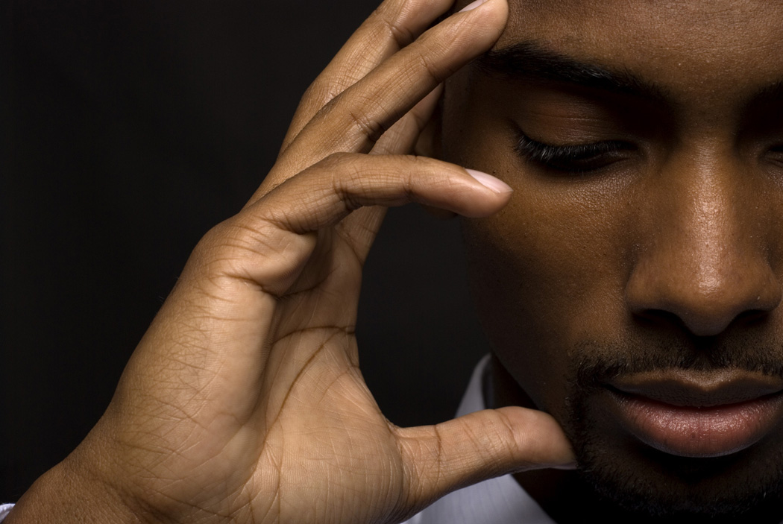
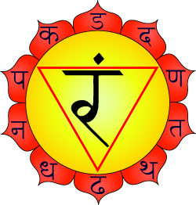

Master Key System
Part Fourteen
The Creative Power of Thought
Conscious
Mind Thought is a Spiritual
| and Creative Principle
|
|
Subconscious
Mind

Slide 3

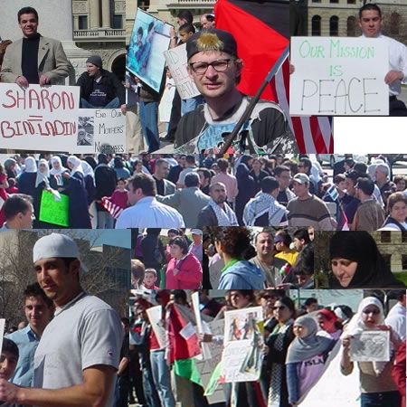

Master Key System
Part Fourteen
The Creative Power of Thought
“Don’t ever invite me to an “anti” war rally, but if you should decide to have a rally for peace, I would love to come.” Mother Theresa
vs

Slide 4
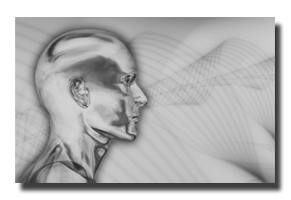
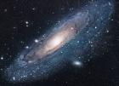
Master Key System
Part Fourteen
The Creative Power of Thought
You are the channel by which the Universe produces phenomena
-----------
Universal Source…………………………………Individuated
“God lives and moves and has Its being through You”

Slide 5

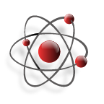

Master Key System
Part Fourteen
The Creative Power of Thought
The Energetic Field
Atoms Molecules
Matter Particles

Slide 6



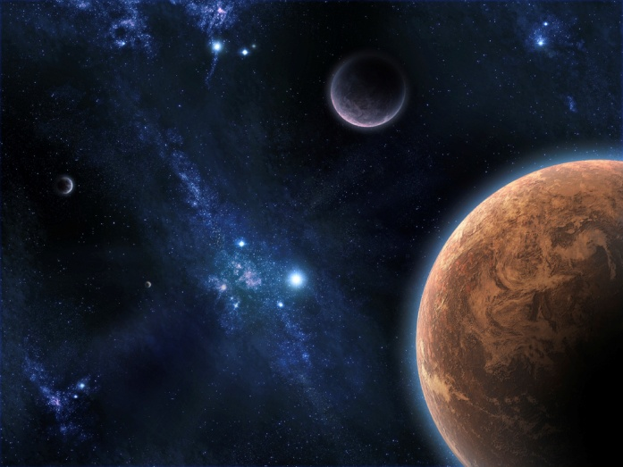

Master Key System
Part Fourteen
The Creative Power of Thought
Speed of Light
(186,000 miles per second)
Universe 93 Billion Light Years 8 Light Minutes from Earth
(8 min. 19 seconds)

Slide 7
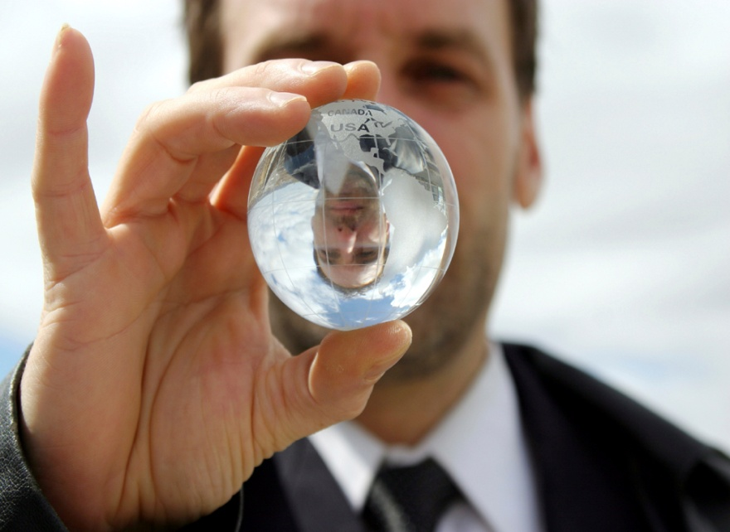

Master Key System
Part Fourteen
The Creative Power of Thought
All things have their origin in mind, and appearances are the result of thought.
Since they are produced
by thought, they can be
erased by thought.
You are the reflection of
the thoughts you entertain
during your lifetime.
Your world without will be a
reflection of your world
within.

Slide 8
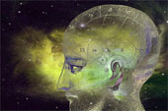

Master Key System
Part Fourteen
The Creative Power of Thought
The Objective world is controlled by the Infinite
Universal Mind
Unseen Infinite
Unexplainable God
Essence Principle
Omnipotent Unlimited
Omnipresent Resourceful
“You are an expression and a manifestation of that mind.”

Slide 9

Master Key System
Part Fourteen
The Creative Power of Thought
“You are what you think.
All that you are arises with
your thoughts.
With your thoughts
you make your world.”
…Buddha

Slide 10

Part Fourteen
Main Points
The source of all Wisdom, Power and Intelligence is the Universal Mind.
Motion, light, heat, and color have their origin in the Universal Energy.
The creative power of thought originates in the Universal Mind.
Thought is Mind in motion.
You are the means by which the Universe produces phenomena.

Slide 11

Part Fourteen
Main Points
Your ability to think is your ability to act upon the Universal Mind.
The first form the Universe takes is electrons which fills all space.
All things have their origin in the Universal Mind.
A change of thought will result in a change of conditions.
A harmonious mental attitude will yield harmonious conditions in life.

Slide 12
Part Fourteen
Study Questions
What is the source of all Wisdom, Power and Intelligence? The Universal Mind.
Where do all motion, light, heat and color have their origin? In the Universal Energy which is one manifestation of the Universal Mind.
Where does the creative power of thought originate? In the Universal Mind.
What is thought? Mind in motion.
How is the Universal differentiated in form? You are the means by which the Universal produces the various combinations which result in formation of phenomena.

Slide 13

Part Fourteen
Study Questions
How is this accomplished? Your power to think is your ability to act upon the Universal and bring it into manifestation.
What is the first form which the Universal takes so far as we know? Electrons which fill all space.
Where do all things have their origin? In Mind.
What is the result of a change of thought? A change in conditions.
What is the result of a harmonious mental attitude? Harmonious conditions in life. Thought, immaterial though it may be, is the matrix that shapes the issues of life.

