Slide 1

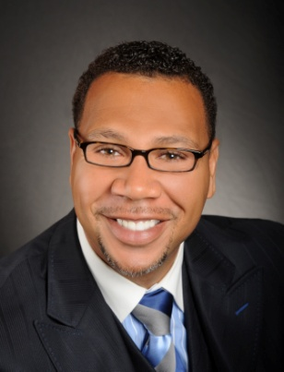

Master Key System
Part Four
“Reversing the Process: Cause and Effect”
Presented
by
Dr. Peter C. Rogers, D.D., PhD.

Slide 2
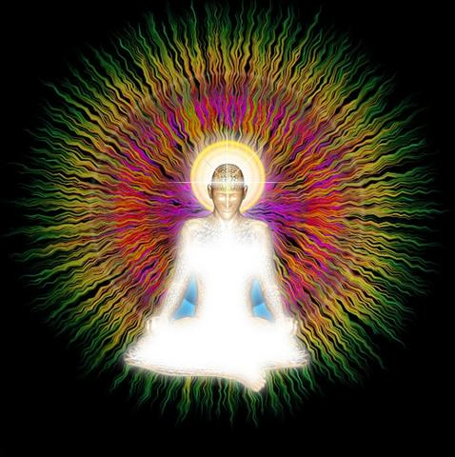

Master Key System
Part Four
Reversing The Process: Cause and Effect
“Thought is energy and energy is power”
What you think or do or feel, is an indication of what you are.
You become what you think and hear yourself say you are.

Slide 3

Master Key System
Part Four
Reversing The Process: Cause and Effect
The real “I” is Spiritual
It is your connection to the Universal
The only difference between the “I” and the Universal is one of degree. (ex…Ocean)
The world within is controlled by the “I” and this “I” is part of the Universal Energy or Spirit.

Slide 4
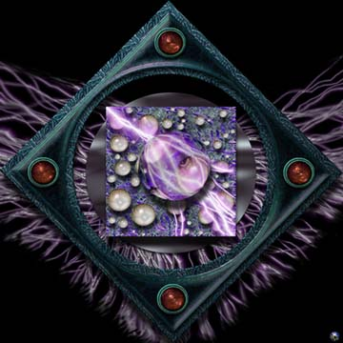

Master Key System
Part Four
Reversing The Process: Cause and Effect
The world “within” is controlled by the “I” and the “I” is one with the Infinite which is the Universal Energy or Spirit, usually called God.
We are coming to think of God as dwelling in man rather than as operating on men from “without.”
“Know ye not that ye are the temple of the living God”

Slide 5


Master Key System
Part Four
Reversing The Process: Cause and Effect
Service
The more you give the more you get
Once person invest in a stock that doubles. That person invested $1,000 receiving $2,000. A profit of $1,000.
Another person invested $10,000 receiving $20,000 profiting him $10,000.

Slide 6
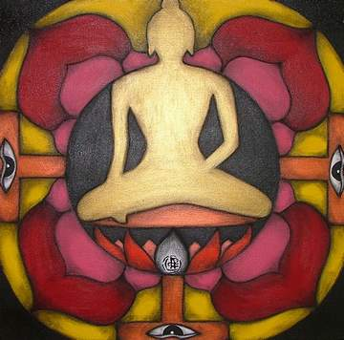

Master Key System
Part Four
Reversing The Process: Cause and Effect
Meditation
You should therefore seek the silence frequently.
Power comes through repose; it is in the silence that you can be still and when you are still, you can think, and thought is the secret to all attainment.

Slide 7
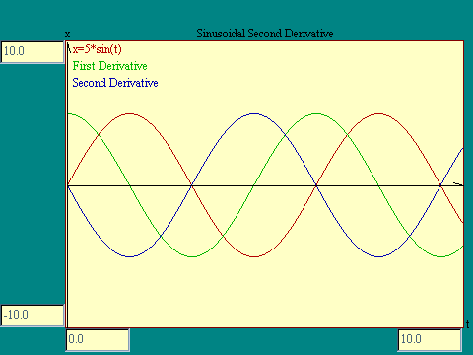


Master Key System
Part Four
Reversing The Process: Cause and Effect
Thought is carried by the “Law of Vibration.”
It receives vitality by emotions through the “Law of Love.”
It takes form through the “Law of Growth.”
Your level of belief will influence how quickly your dreams become reality.

Slide 8

Part Four
Main Points
Thought is spiritual energy.
Thought is carried by the Law of Vibration.
Thought is given vitality by the Law of Love.
Thought takes form by the Law of Growth.
The secret of the creative process is that it is a spiritual activity.

Slide 9

Part Four
Main Points
You may develop the faith, courage and enthusiasm that will result in accomplishments by recognizing your spiritual nature.
Service is the secret of power because you get what you give.
Silence is a physical stillness.
Silence is the first step to self-control and self mastery.

Slide 10

Part Four
Study Questions
What is thought? Thought is spiritual energy.
How is it carried? By the Law of Vibration.
How is it given vitality? By the Law of Love.
How does it take form? By the Law of Growth.
What is the secret of its creative power? It is a spiritual activity.

Slide 11

Part Four
Study Questions
How may we develop the faith, courage and enthusiasm which will result in accomplishment? By recognition of your spiritual nature.
What is the secret of Power? Service
Why is this so? Because you get what you give.
What is the Silence? A physical stillness.
Of what value is it? It is the first step to self-control and self-mastery.

