Slide 1



Master Key System
Part Five
“The Creative Mind”
Presented
by
Dr. Peter C. Rogers, D.D., PhD.

Slide 2


Master Key System
Part Five
The Creative Mind
At least ninety percent of our mental life is subconscious
10 % Conscious-----------
Those who fail to make use of this mental power live within very narrow limits.

Slide 3


Master Key System
Part Five
The Creative Mind
Mind in action is thought, and thought is creative
Matter is powerless, passive, inert. Mind is force, energy, power.
Mind shapes and controls matter. Every form which matter takes is but the expression of some pre-existing thought.
It manifest in your conduct and actions
Thought=Action=Habit=Character=Destiny

Slide 4

Master Key System
Part Five
The Creative Mind
Every form which matter takes is but the expression of some pre-existing thought
You are today the result of your past thinking.
Tomorrow you will be the result of today’s thoughts.

Slide 5
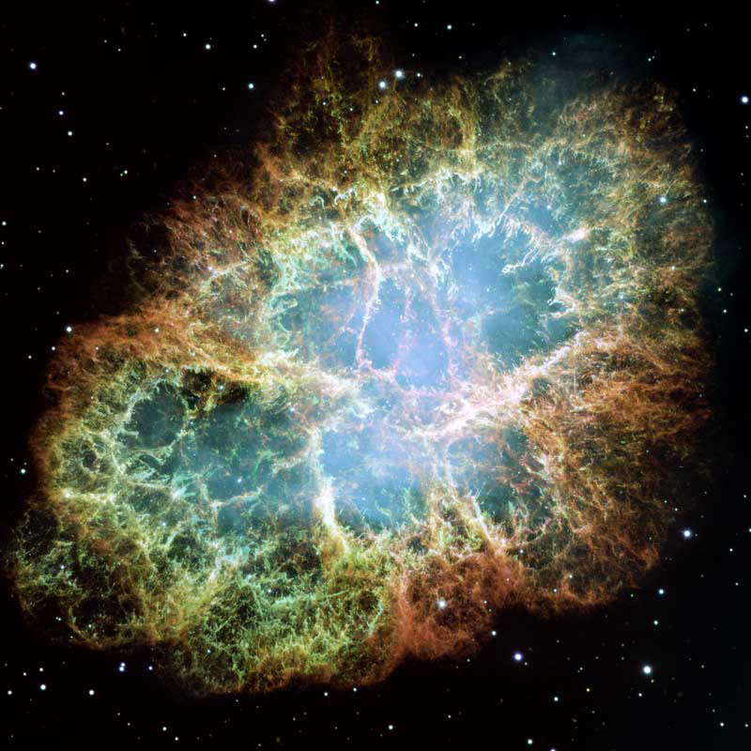

Master Key System
Part Five
The Creative Mind
The Infinite Life flows through you; it is you.
The great fact is, that the source of all life and all power is from within. Persons, circumstances, and events may suggest need and opportunities, but the insight, strength and power to answer these needs will be found within.
Know ye not that ye are gods…

Slide 6

Part Five
Main Points
At least ninety percent (90%) of your mental life is subconscious.
This vast storehouse is not utilized because very few understand it.
The Conscious Mind received its information from heredity and is the result of all past generations.
The Law of Attraction will bring you “your own,” which is the result of past thinking. (Conscious or Unconscious)

Slide 7

Part Five
Main Points
The thoughts you entertain are the materials you use to construct your mental home.
The secret of power is a recognition of the omnipresence of omnipotence.
All life and all power originates from “within.”
The possession of power is contingent upon proper use of the power already in your possession.

Slide 8

Part Five
Study Questions
What proportion of our mental life is Subconscious? At least ninety percent (90%)
Is this vast mental storehouse generally utilized? No
Why not? Few understand or appreciate the fact that it is an activity which they may consciously direct.
Where has the Conscious Mind received its governing tendencies? From heredity which means that it is the result of all the environments of all past generations.
What is the Law of Attraction bringing to us? Our own.

Slide 9

Part Five
Study Questions
What is your “Own?” What you inherently are, and is the result of your past thinking, both conscious and unconscious.
Of what is the material with which you construct your mental home composed? Thoughts which you entertain.
What is the secret of power? A recognition of the omnipresence of omnipotence.
Where does it originate? All life and all power is from within.
Upon what is the possession of power contingent? Upon a proper use of the power already in you possession.

