Slide 1

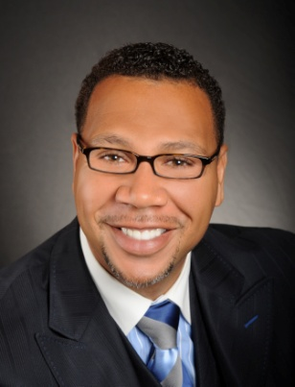

Master Key System
Part Eleven
“Inductive Reasoning and the Objective Mind”
Presented
by
Dr. Peter C. Rogers, D.D., PhD.

Slide 2

Master Key System
Part Eleven
Inductive Reasoning and The Objective Mind
Your life is governed by law, it is in operation at all times; in all places. Fixed laws underlie all human actions.
(Gravity…)

Slide 3

Master Key System
Part Eleven
Inductive Reasoning and The Objective Mind
Every Effect is the result of a Cause which in turn becomes an Effect which creates other Causes…

Slide 4

Master Key System
Part Eleven
Inductive Reasoning and The Objective Mind
“Like attracts like in the mental world”
Your thoughts
bring certain friendships
and companionships
of a particular kind.
Your thoughts
bring about the
conditions and
environments that
you complain about.

Slide 5

Master Key System
Part Eleven
Inductive Reasoning and The Objective Mind
“What things soever ye desire, when ye pray, believe that ye receive them, and ye shall have them”

Slide 6


Master Key System
Part Eleven
Inductive Reasoning and The Objective Mind
You must first believe that your desire has already been fulfilled and its accomplishment will then follow
Make your desires an already existing fact!
The Subconscious does not take into consideration time and space. It can only comprehend NOW. Once you identify your goals, it is then necessary to affirm and visualize them in the HERE & NOW, as if they have already been completed.

Slide 7




Master Key System
Part Eleven
Inductive Reasoning and The Objective Mind
“Believe that ye receive and ye shall receive.”
“Faith is the substance of things hoped for, the evidence of things not seen.”
“The Law of Attraction is the law by which thought correlates with its object.”

Slide 8

Part Eleven
Main Points
Inductive reasoning is the process of the objective mind.
Need, want, and desire induce, guide and determine action.
The solution to every problem is to believe that your desire has already been fulfilled. Its accomplishment will then follow.
Plant your thoughts in the subjective mind which will germinate them into fruition.

Slide 9

Part Eleven
Main Points
This process is scientifically exact because it is Natural Law.
Faith is the substance of things hoped for, the evidence of things unseen.
The Law of Attraction is the law by which Faith is brought into manifestation.

Slide 10

Part Eleven
Study Questions
What is inductive reasoning? The process of the objective mind by which we compare a number of separate instances with each other until we see the common factor which gives rise to them all.
What has this method of studying accomplished? It has resulted in the discovery of a reign of law which has marked an epoch in human progress.
What is it that guides and determines action? It is need, want and desire which in the largest sense induce, guide and determine action.
What is the formula for the unerring solution of every individual problem? We are to believe that our desire has already been fulfilled; its accomplishment will then follow.
What great teachers advocated it? Jesus, Plato, Swedenborg.

Slide 11
Part Eleven
Study Questions
What is the result of this thought process? We are thinking on the plane of the absolute and planting a seed, which if left undisturbed will germinate into fruition.
Why is it scientifically exact? Because it is Natural Law.
What is Faith? “Faith is the substance of things hoped for, the evidence of things unseen.”
What is the Law of Attraction? The law by which faith is brought into manifestation.
What importance do you attach to an understanding of this law? It has eliminated the elements of uncertainty and caprice from men’s lives and substituted law, reason, and certitude.

