Slide 1

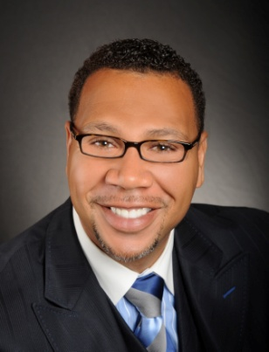

Master Key System
Part Eighteen
“The Law of Attraction”
Presented
by
Dr. Peter C. Rogers, D.D., PhD.

Slide 2

Master Key System
Part Eighteen
The Law of Attraction
The whole world is on the eve of a new consciousness, a new power, and a new realization within the self.
Physical science has resolved matter into molecules, molecules into atoms and atoms into energy

Slide 3




Master Key System
Part Eighteen
The Law of Attraction
Creative power originates in the Universal Mind
Universal Mind….Individuated
You are the means by which the Universe creates
Your thought is the invisible link to the Universal Mind

Slide 4

Master Key System
Part Eighteen
The Law of Attraction
Like attracts like on the mental plane
Mental vibrations respond to their vibratory frequency

Slide 5



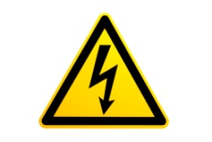

Master Key System
Part Eighteen
The Law of Attraction
Thought is the energy which the Law of Attraction is brought into operation.
The Universal Mind is static. Your thoughts are dynamic mind in action.
Power depends upon consciousness of power.
The use of power depends upon your attention and your degree of attention determines your capacity of knowledge.

Slide 6

Master Key System
Part Eighteen
The Law of Attraction
The incentive of attention is interest
The greater the interest, the greater the attention.
The greater the attention, the greater the interest.
This interest will attract more attention.
This attention will produce more interest
“What gets your attention will get you”

Slide 7

Master Key System
Part Eighteen
The Law of Attraction
BE HERE NOW
____________________ _______________________
The Past The Future
Shame Worry
Nostalgia Fear
Fear NOW Anxiety
Bad Programming Wasteful Thoughts

Slide 8
Part Eighteen
Main Points
The difference in individual lives is measured by the degree of intelligence that you manifest.
You may control other forms of intelligence by recognizing yourself as an individualization of the Universal Intelligence.
The creative power originates in the Universal.
The Universal creates form through you.
Thought is the connecting link between you and the Universal.

Slide 9

Part Eighteen
Main Points
The Law of Love is the principle by which the means of existence is carried into effect.
The Law of Growth brings this principle into expression.
The Law of Growth depends upon reciprocal action. You are complete at all times and this makes it possible for you to receive according to what you give.
What you think is thought.
You receive thought, which is substance in equilibrium and which is constantly being differentiated in form by what you think.

Slide 10
Part Eighteen
Study Questions
How is the difference in individual lives measured? By the degree of intelligence which you manifest.
What is the law by which you may control other forms of intelligence? A recognition of yourself as an individualization of the Universal Intelligence.
Where does the creative power originate? In the Universal.
How does the Universal create form? By means of the individual.
What is the connecting link between you and the Universal? Thought.

Slide 11
Part Eighteen
Study Questions
What is the principle by which the means of existence is carried into effect? The Law of Love.
How is this principle brought into expression? By the Law of Growth.
Upon what condition does the Law of Growth depend? Upon reciprocal action. You are complete at all times and this makes it possible to receive only as you give.
What is it that you give? Thought.
What do you receive? Thought, which is substance in equilibrium and which is constantly being differentiated in form by what you think.

